Slide 1

MACHINE LEARNING
(24AD2204)
Lecture - 2
Applications of Machine Learning, Issues in ML

Slide 2
RECAP

Slide 3
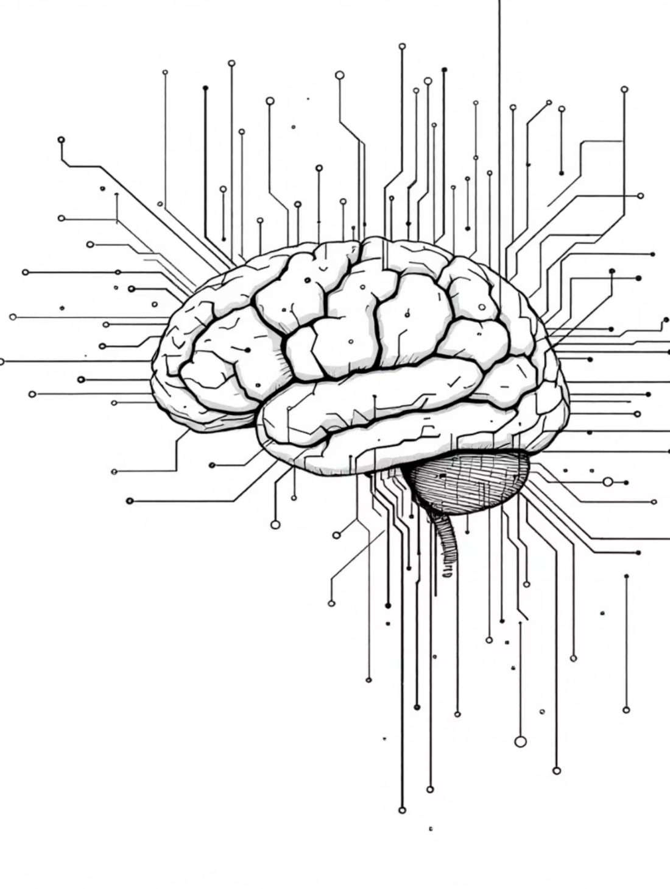
When to Use Machine Learning
Machine learning transforms how we solve complex problems, but it's not a universal solution. Understanding when and where to apply it is crucial for success.

Slide 4
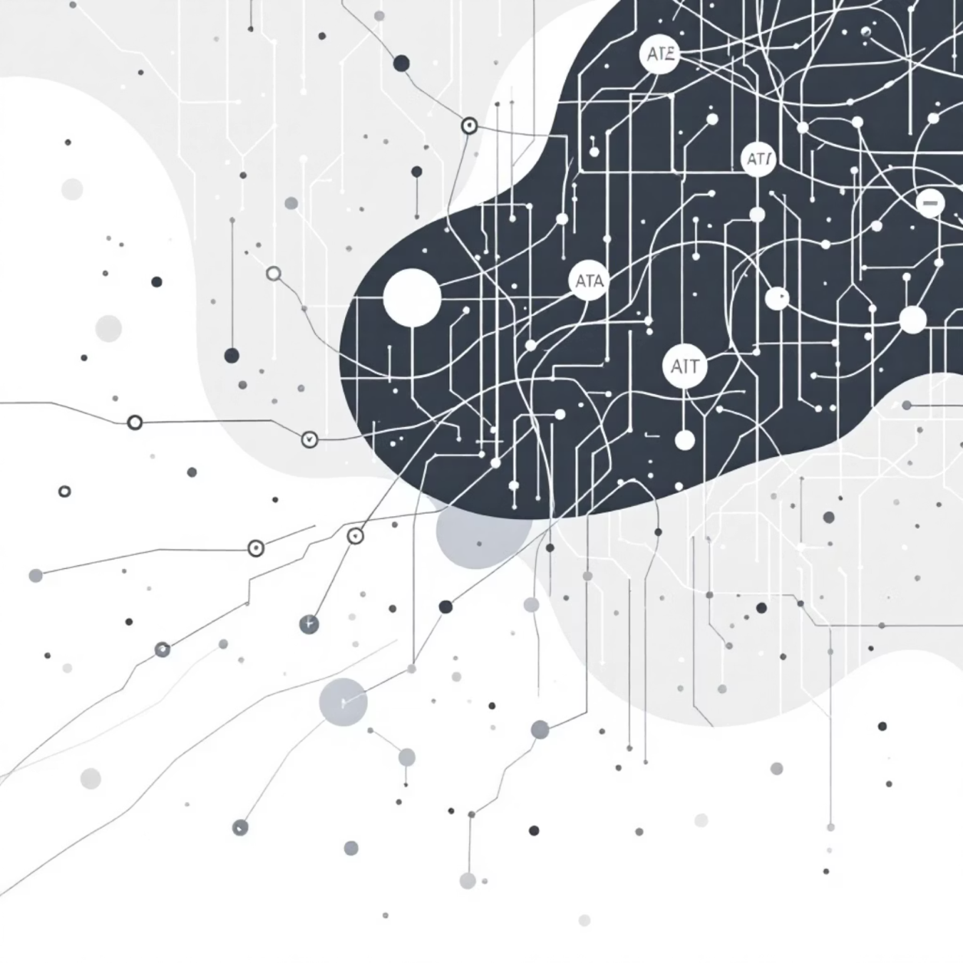
Understanding the Fundamentals
The Machine Learning Philosophy
Machine learning imitates human learning—learning from expert guidance and experience. The process divides into three essential parts that work together to create intelligent systems.
Data Input utilizes past data as a basis for future decisions. Abstraction represents input data in a summarized way. Generalization creates a framework for making decisions from abstracted representations.

Slide 5
When NOT to Use Machine Learning
High Human Involvement Tasks
Simple Rule-Based Tasks
Air traffic control requires intense human involvement and complex decision-making. Machine learning cannot replace critical human judgment in these scenarios.
Traditional programming handles simple applications better. Price calculator engines and dispute tracking systems don't need machine learning techniques.
Already Optimized Processes
Insufficient Training Data
If the business process is already optimized, incorporating machine learning won't justify the return on investment.
Small training datasets exponentially worsen the impact of bad data. Quality predictions require sizeable training data.

Slide 6
Three Types of Machine Learning
Supervised Learning
Unsupervised Learning
Reinforcement Learning
Also called predictive learning. Predicts class or value of unknown objects based on prior information.
Also called descriptive learning. Finds groups or patterns by grouping similar objects together.
Machines learn to act independently to achieve given goals through trial and error.
Self-driving cars
Tumor classification
Customer segmentation
Intelligent robots
Price prediction in real estate and stocks
Recommender systems
Game-playing AI
Pattern discovery
Customer behavior forecasting

Slide 7



Banking & Finance Applications
Fraud Detection
Real-time identification of fraudulent credit card transactions. High-performance models spot and prevent fraud at the moment of occurrence.
Customer Churn Prevention
Descriptive learning identifies problem areas. Predictive learning spots vulnerable customers likely to leave, enabling proactive retention strategies.
Leading banks globally implement these solutions to handle high volumes and velocity of transactions, avoiding operational hassles in dispute settlement.

Slide 8

Insurance Industry Solutions
The insurance industry is extremely data-intensive, making it ideal for machine learning applications. Two major areas benefit significantly from these technologies.
Risk Prediction
During customer onboarding, past information predicts new customer risk profiles. Risk quantum determines quote generation for prospective customers.
Claims Management
Historic claims and adjustor notes predict fraudulent claim possibilities. Models consider information from similar customers—same location, age group, ethnic group.

Slide 9

Healthcare Revolution
Wearable Device Monitoring
Medical Imaging Diagnosis
Real-time health condition prediction from wearable data. Immediate alerts for health issues enable preventive action. Extreme problems trigger doctor and healthcare provider notifications.
Machine learning combined with computer vision plays a crucial role in disease diagnosis from medical imaging, improving accuracy and speed.
Real-World Example: An elderly person's wearable detects dangerous blood pressure spike during morning walk. The model predicts fatality risk, alerts the person to rest, and notifies nearby healthcare providers to standby.

Slide 10





Popular Machine Learning Tools
Python
R
MATLAB
Most popular open source language. Strong libraries: NumPy (math), SciPy (algorithms), matplotlib (plotting), scikit-learn (machine learning). Designed by Guido van Rossum, first released 1991.
Language for statistical computing. Extremely popular in academia among statisticians and data miners. Key libraries: plyr/dplyr, caret, ggplot2. Supported by R Foundation.
Licensed commercial software with robust numerical computing support. Professionally developed by MathWorks since 1984. Scales for large datasets via parallel processing.
SAS
Other Tools
Statistical Analysis System. Licensed software suite with components like Base SAS, SAS/INSIGHT, Enterprise Miner. First released 1976, developed in C.
SPSS (IBM-owned), Julia (open source, released 2012). Each offers specialized capabilities for different machine learning needs and use cases.

Slide 11




Critical Issues & Ethical Considerations
Privacy Concerns
Adverse Reactions
The biggest fear: privacy breach. Analysis reveals private facts about people. Different people have different sharing preferences—birthdays, photos, education. Inadvertent use may upset people or trigger legal action.
Actions based on machine learning may create negative responses. Example: election campaigns using demographic insights might upset voters and cause adverse results.
Human Judgment Required
Critical consideration: exercise proper human judgment before using machine learning outcomes. Only then will decisions be beneficial without adverse impact.
Laws, regulations, cultural backgrounds, and emotional maturity vary drastically between countries, making machine learning issues quite different across regions.

Slide 12
Summary
Learning Philosophy
Machine learning imitates human learning from expert guidance and experience through data input, abstraction, and generalization.
Right Problem Selection
Decide whether the problem is appropriate for machine learning before starting. Not all problems benefit from this approach.
Three Categories
Supervised (predictive), Unsupervised (descriptive), and Reinforcement learning each serve different purposes and applications.
Industry Adoption
Banking, Insurance, Healthcare, and other domains successfully solve problems using machine learning technologies.
Platform Choices
Python, R, MATLAB, SAS, and SPSS are the most widely adopted platforms for implementing machine learning solutions.
Ethical Responsibility
Critical consideration and human judgment required before applying machine learning to avoid ethical issues and ensure beneficial outcomes.

Slide 13
SUMMARY

Slide 14

THANK YOU!

